Slide 1
Project 5:Sentiment Analysis for Marketing
PHASE-3: DEVELOPMENT PART 1

Slide 2
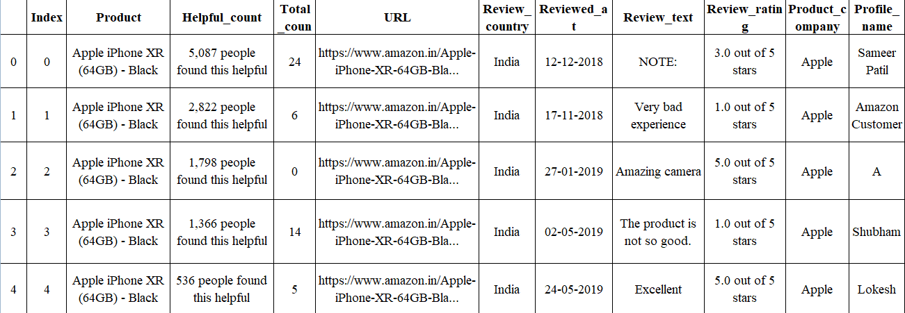
Loading of dataset:

Slide 3
Preprocessing:
df=pd.read.csv(‘/kaggle/input/apple-iphone-11-reviews-from-amazon-com/apple_iphone_11_reviews.csv')
df.head()
df.isna().sum()
index 0
product 0
helpful_count 0
total_comments 0
url 0
review_country 0
reviewed_at 0
review_text 3
review_rating 0
product_company 0
profile_name 0
review_title 2
dtype: int64

Slide 4
df.dropna(inplace=true)
df.shape
df.info()
<class 'pandas.core.frame.DataFrame'>
Int64Index: 5007 entries, 0 to 5009
Data columns (total 12 columns):
# Column Non-Null Count Dtype
--- ---------- -------------------- --------
0 index 5007 non-null int64
product 5007 non-null object
helpful_count 5007 non-null object
total_comments 5007 non-null int64
url 5007 non-null object
review_country 5007 non-null object
reviewed_at 5007 non-null object
review_text 5007 non-null object
review_rating 5007 non-null object
product_company 5007 non-null object
profile_name 5007 non-null object
review_title 5007 non-null object
dtypes: int64(2), object(10)
memory usage: 508.5+ KB

Slide 5
df['reviewed_at']=pd.to_datetime(df['reviewed_at'])
print('All index column values are unique?: ',len(df.index)==df.index.nunique())
df.drop(['index'], axis=1, inplace=True)
All index column values are unique?: True
def find_likes(x):
likes=x.split()[0]
if likes=='One': return 1
elif ',' in likes: return int(likes.replace(',', ''))
else: return int(likes)
df['likes']=df['helpful_count'].apply(find_likes)
def find_rating(x):
rating=x.split()[0]
return float(rating)
df['rating']=df.review_rating.apply(find_rating)
df.rating.value_counts()
5.0 3730
4.0 718
1.0 319
3.0 153
2.0 87
Name: rating, dtype: int64

Slide 6
df.drop(['helpful_count', 'review_rating'], axis=1, inplace=True)
df.drop(['url'], axis=1, inplace=True)
numeric=df.select_dtypes('number').columns
categoric=df.select_dtypes('object').columns
print('Numeric Columns: ', numeric)
print('Categoric Columns: ', categoric)
Numeric Columns:
Index(['total_comments', 'likes', 'rating'], dtype='object')
Categoric Columns:
Index(['product', 'review_country', 'review_text', 'product_company', 'profile_name', 'review_title'], dtype='object')

